Slide 1
Deep Neural Networks for YouTube Recommendations Paul Covington, Jay Adams, Emre Sargin
報告者：610721204 陳克威
日 期：2019/05/23

Slide 2
Introduction

Slide 3
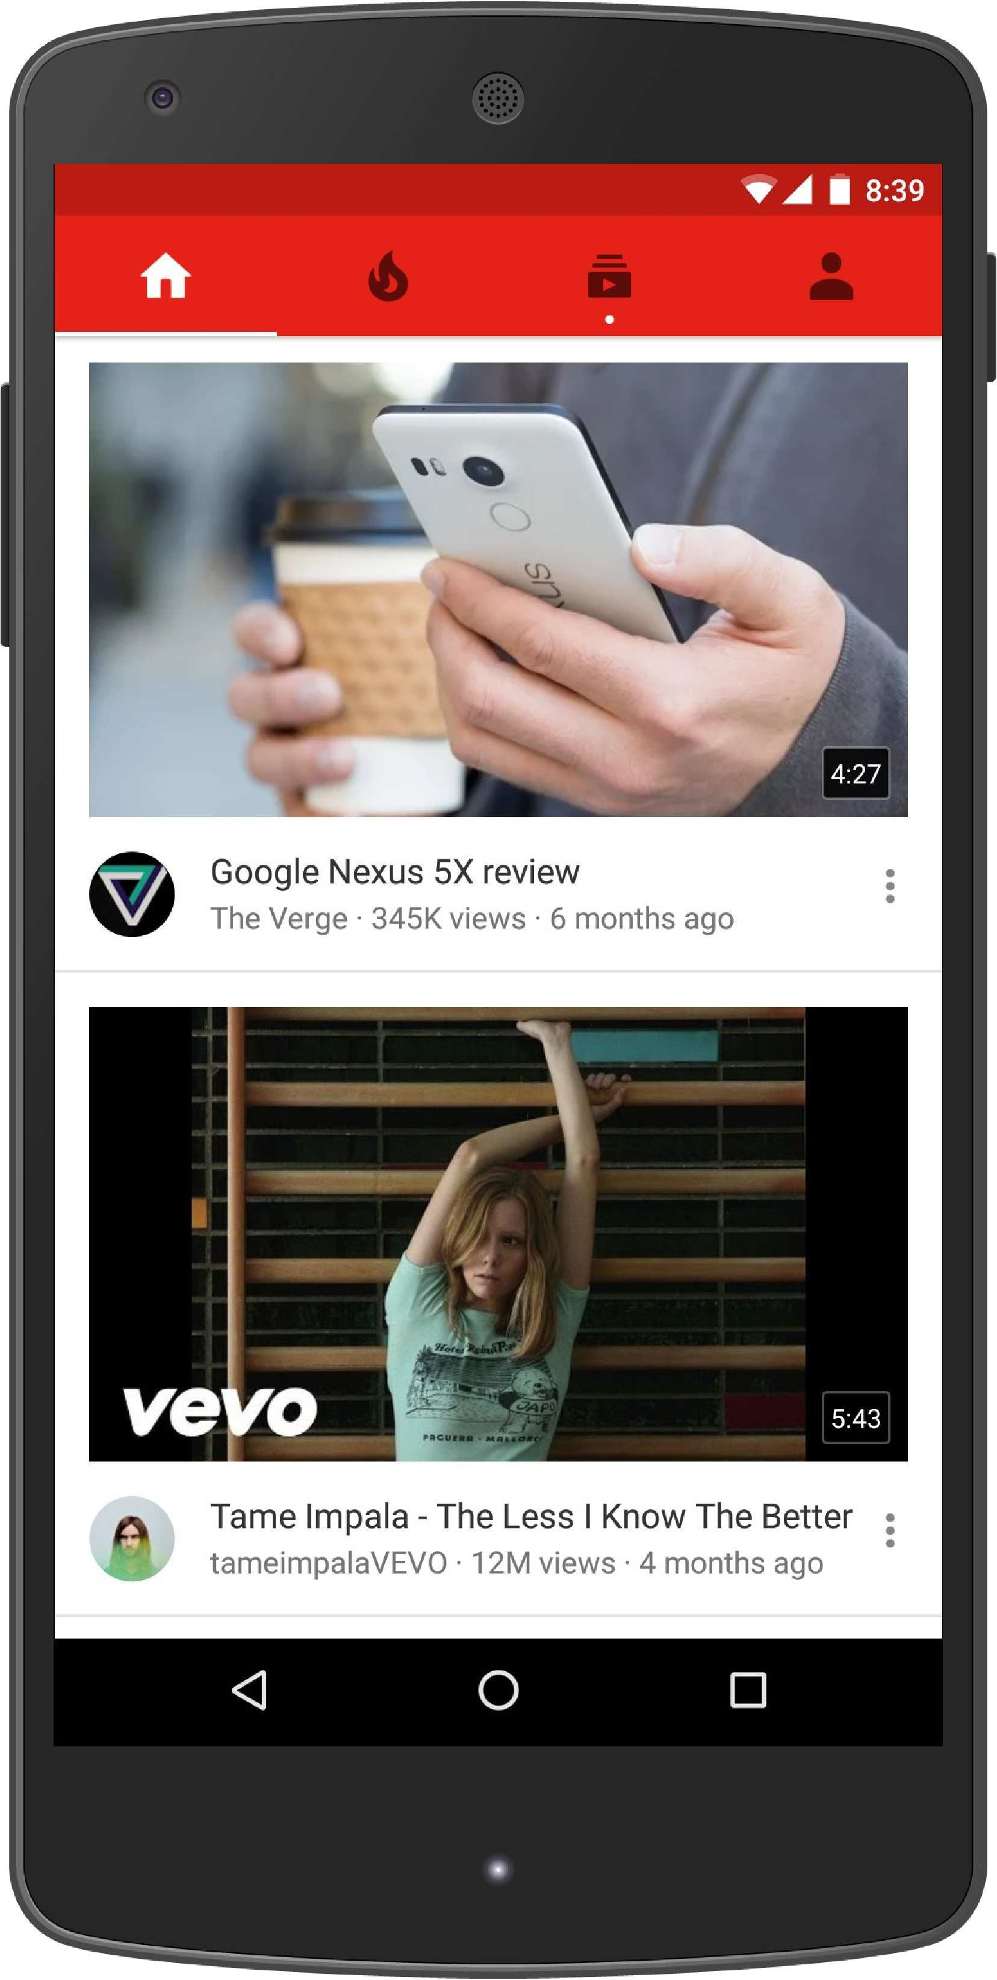
Introduction
YouTube recommendations are responsible for helping more than a billion users
discover personalized content from an ever-growing corpus of videos.
Notes:
YouTube推薦有助於幫助超過10億用戶從不斷增長的視頻中發現個性化內容。

Slide 4
Introduction
Scale: Many existing recommendation algorithms proven to work well on small problems fail to operate on our scale.
Freshness: YouTube has a very dynamic corpus with many hours of video are uploaded per second.
Noise: We rarely obtain the ground truth of user satisfaction and instead model noisy implicit(隱性的) feedback signals.
Notes:
規模：許多現有的推薦算法證明在小問題上運行良好，無法在我們的規模上運行。
新鮮度：YouTube擁有非常動態的語料庫，每秒上傳數小時的視頻。
噪音：我們很少獲得用戶滿意度的基本事實，而是模擬噪聲隱式反饋信號。

Slide 5
Introduction
Our system is built on Google Brain which was recently open sourced as TensorFlow.
Our models learn approximately one billion parameters and are trained on hundreds of billions of examples.
Notes:
我們的系統建立在Google Brain上，最近開源為TensorFlow。
我們的模型學習了大約10億個參數，並接受了數千億個示例的培訓。

Slide 6
Introduction (Related Work)
In contrast to vast amount of research in matrix factorization methods [19], there is relatively little work using deep neural networks for recommendation systems.
Neural networks are used for recommending news in [17], citations in [8] and review ratings in [20].
Collaborative filtering is formulated as a deep neural network in [22] and autoencoders in [18].
Elkahky et al. used deep learning for cross domain user modeling [5].
In a content-based setting, Burges et al. used deep neural networks for music recommendation [21].
Notes:
與矩陣分解方法[19]中的大量研究相比，使用深度神經網絡進行推薦系統的工作相對較少。
神經網絡用於推薦[17]中的新聞，[8]中的引文和[20]中的評論等級。
協同過濾在[22]和[18]中的自動編碼器中被公式化為深度神經網絡。
Elkahky等。 使用深度學習進行跨域用戶建模[5]。
在基於內容的環境中，Burges等人。 使用深度神經網絡進行音樂推薦[21]。

Slide 7
System Overview

Slide 8
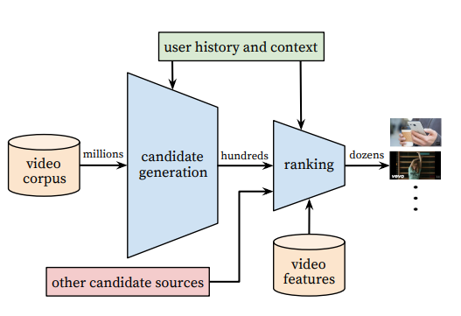
System Overview
These candidates are intended to be generally relevant to the user with high precision.
The candidate generation network only provides broad personalization via collaborative filtering.
The similarity between users is expressed in terms of coarse features such as IDs of video watches,
search query tokens and demographics.
Notes:
這些候選者通常與用戶通常具有高精度相關。
候選生成網絡僅通過協同過濾提供廣泛的個性化。
用戶之間的相似性以粗略(coarse)特徵表示，例如視頻的ID，搜索和人口統計。

Slide 9
System Overview
The ranking network accomplishes this task by assigning a score to each video according to a desired objective function using a rich set of features describing the video and user.
The highest scoring videos are presented to the user, ranked by their score.
Notes:
排名網絡通過使用描述video和user的豐富特徵集根據期望的目標函數為每個視頻分配分數來完成該任務。
評分最高的視頻將呈現給用戶，按其分數排名。

Slide 10
System Overview
During development, we make extensive use of offline metrics (precision, recall, ranking loss, etc.) to guide iterative improvements to our system.
However for the final determination of the effectiveness of an algorithm or model, we rely on A/B testing via live experiments.
In a live experiment, we can measure subtle changes in click-through rate, watch time, and many other metrics that measure user engagement.
This is important because live A/B results are not always correlated with offline experiments.
Notes:
在開發過程中，我們廣泛使用離線指標（精確度，召回率，排名損失等）來指導我們系統的迭代改進。
然而，為了最終確定算法或模型的有效性，我們依靠通過實時實驗進行A / B測試。
在 live experiment中，我們可以”點擊率”，觀看時間以及”用戶參與度”的許多其他指標的細微變化。
這很重要，因為實時A / B結果並不總是與離線實驗相關。

Slide 11
Candidate Generation

Slide 12
Candidate Generation
The predecessor to the recommender described here was a matrix factorization approach trained under rank loss.
Early iterations of our neural network model mimicked this factorization behavior with shallow networks that only embedded the user’s previous watches.
From this perspective, our approach can be viewed as a nonlinear generalization of factorization techniques.
Notes:
這裡描述的推薦器的前身是在等級損失下訓練的矩陣分解方法。
早期也透過DL做了矩陣分解，但是只對用戶的觀看記錄做了embedding。
從這個角度來看，我們的方法可以被視為分解技術的非線性推廣。

Slide 13


Recommendation as Classification
Extreme Multiclass Classification
U = User
C = Context
Wt = 時間點t
i = video
= a high-dimensional “embedding” of the user, context pair
= embeddings of each candidate video.
Softmax
Notes:
DNN的任務是根據用戶的歷史和上下文來學習用戶嵌入u，這對於用softmax分類器區分視頻是有用的。

Slide 14
Recommendation as Classification
To efficiently train such a model with millions of classes, we rely on a technique to sample negative classes from the background distribution (“candidate sampling”) and then correct for this sampling via importance weighting [10].
For each example the cross-entropy loss is minimized for the true label and the sampled negative classes.
In practice several thousand negatives are sampled, corresponding to more than 100 times speedup over traditional softmax.
Notes:
為了有效地訓練具有數百萬個類的這種模型，我們依靠一種技術從背景分佈中採樣負類（“候選採樣”），
然後通過重要性加權來校正這種採樣[10]。
對於每個示例，對於真實標籤和採樣的負類，交叉熵損失最小化。
在實踐中，對數千個負片進行採樣，相當於傳統softmax的100倍以上。

Slide 15
Recommendation as Classification
Previous systems at YouTube relied on hashing [24] and the classifier described here uses a similar approach.
Since calibrated likelihoods from the softmax output layer are not needed at serving time, the scoring problem reduces to a nearest neighbor search in the dot product space for which general purpose libraries can be used [12].
We found that A/B results were not particularly sensitive to the choice of nearest neighbor search algorithm.
Notes:
YouTube以前的系統依賴於 hashing[24]，這裡描述的分類器使用類似的方法。
由於在服務時不需要來自softmax輸出層的校準似然，因此評分問題減少到可以使用通用庫的點積空間中的最近鄰搜索[12]。
我們發現A / B結果對最近鄰搜索算法的選擇不是特別敏感。

Slide 16
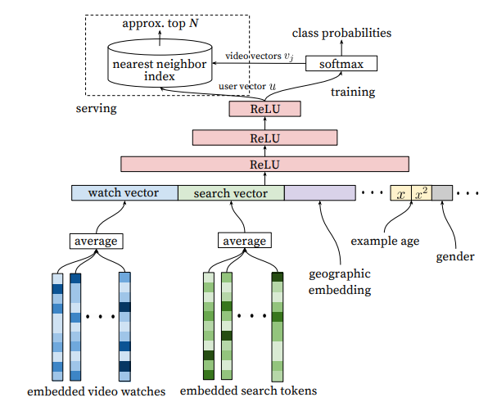
Model Architecture
Search tokens → uni-gram or bi-gram
Geographic → gender,
logged-in state,
age(0~1 normalized), etc.
Inspired by continuous bag of words language models ,we learn high dimensional embeddings for each video in a fixed vocabulary and feed these embeddings into a feedforward neural network.
Notes:
Word2vec – 2013
受到CBOW的啟發，為每個video建一個固定的詞彙表(計算相似性)。

Slide 17
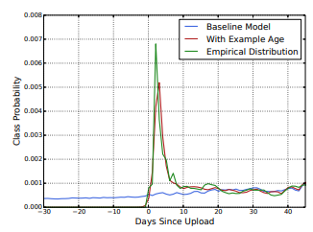
“Example Age” Feature
We consistently observe that users prefer fresh content, though not at the expense of relevance.
Notes:
我們始終注意到用戶更喜歡新鮮內容，但不以犧牲相關性為代價。
(ML更傾向於舊資料)
Empirical distribution = 經驗分佈

Slide 18
Label and Context Selection
We have found that the choice of this surrogate learning problem has an outsized importance on performance in A/B testing but is very difficult to measure with offline experiments.
Notes:
Label & Context
我們發現，這種替代學習問題的選擇對A / B測試的性能有著極大的重要性，但很難用Offline實驗來衡量。

Slide 19
Label and Context Selection
1.訓練樣本要用youtube上的所有影片的觀看記錄，而不只是我們的推薦的視頻的觀看記錄。否則面對新影片的時候很難推薦。
2.為每個user使用固定數量的訓練樣本，在Loss Function中所有user的weight一樣。這能防止一部分非常活躍的用戶主導loss值。
3.要小心的避免Over Fitting，例如搜尋”taylor swift”，分類器拿到這個關鍵詞之後，會預測最有可能被觀看的視頻肯定是出現在”taylor swift”搜索結果頁上的視頻。(這種情況最好要丟棄sequence information)
(也就是使用user的最後一個搜索作為首頁推薦表現會非常糟糕。)
Notes:
用中文講一下他們的經驗法則。

Slide 20
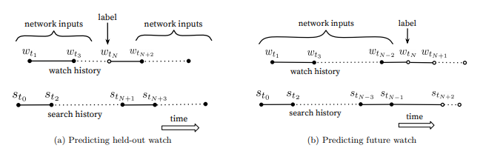
Label and Context Selection
4.user經常先發現最主流的藝術家的video，然後才專注於較小眾的。因此，我們發現預測用戶的[下一個觀看video]的效果要好得多。
(a)的算法其實預知了未來的行為(傳統CF算法常這樣做)，
(這邊應該是做用A/B Tesing發現改成用(b)會比較好。)

Slide 21
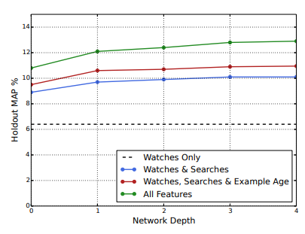
Experiments with Features and Depth
Mean Average Precision (MAP)
In these experiments, a vocabulary of 1M videos and 1M search tokens were embedded with 256 floats each in a maximum bag size of 50 recent watches and 50 recent searches.
The softmax layer outputs a multinomial distribution over the same 1M video classes with a dimension of 256 (which can be thought of as a separate output video embedding).
Notes:
在這些實驗中，包含1M視頻和1M搜索的詞彙表，其中包含256個浮點數，最大包含50個近期觀看和50個近期搜索。
softmax層在相同的1M視頻類上輸出多項分佈，其尺寸為256（可以將其視為單獨的輸出視頻嵌入）。

Slide 22
Ranking

Slide 23
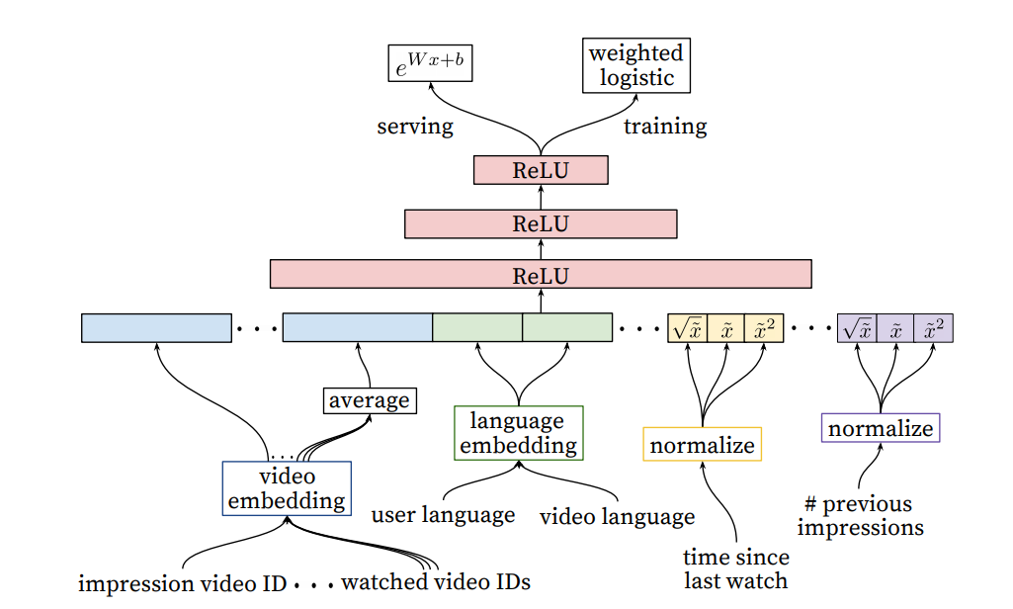
Feature Representation
該影片已經被推薦
的次數
1M->32
Normalize to 0~1
(同一個channel)
Notes:
watch time為優化目標 所以用wegihted

Slide 24
Feature Engineering
We typically use hundreds of features in our ranking models, roughly split evenly between categorical and continuous.
How many videos has the user watched from this channel?
When was the last time the user watched a video on this topic?
Notes:
用數百個特徵，categorical , continuous 大概一半一半。

Slide 25
Feature Representation
Features describing the frequency of past video impressions are also critical for introducing “churn” in recommendations (successive requests do not return identical lists).
If a user was recently recommended a video but did not watch it then the model will naturally demote this impression on the next page load.
Notes:
意思就是說，過去推薦過的，他沒點，那我們就該降低
描述過去視頻展示次數的功能對於在推薦中引入“流失”也很重要（連續請求不會返回相同的列表）。
如果用戶最近推薦了一個視頻，但沒有觀看，那麼該模型會在下一頁加載時自然降低這種印象。

Slide 26
Normalizing Continuous Features
We found that proper normalization of continuous features was critical for convergence.
cumulative distribution(累積分布函數)
Notes:
做normalization 比較好 Convergence = 收斂

Slide 27
Modeling Expected Watch Time
Our goal is to predict expected watch time given training examples that are either positive (the video impression was clicked) or negative (the impression was not clicked).
Positive examples are annotated with the amount of time the user spent watching the video.
To predict expected watch time we use the technique of weighted logistic regression, which was developed for this purpose.
Notes:
我們的目標是預測預期的觀看時間，因為CTR只有正負兩種(不夠)。
正面示例用用戶觀看視頻所花費的時間量來註釋。
為了預測預期的觀察時間，我們使用加權邏輯回歸技術，該技術是為此目的而開發的。

Slide 28
Modeling Expected Watch Time
The positive (clicked) impressions are weighted by the observed watch time on the video.
Negative (unclicked) impressions all receive unit weight.
Notes:
Positive （點擊）展示次數會根據觀看的觀看時間加權。
Negative （未點擊）印像都會獲得單位(一樣的)權重。

Slide 29
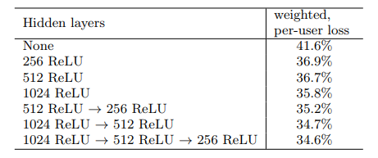
Experiments with Hidden Layers
We first score these two impressions with our model.
If the negative impression receives a higher score than the positive impression, then we consider the positive impression’s watch time to be mispredicted watch time.
Notes:
我們首先使用我們的模型對這兩個印象進行評分。
如果negative得分高於positive ，那麼我們認為positive的觀看時間是[預測錯誤]的觀看時間。

Slide 30
Conclusions

Slide 31
Conclusions
Our deep collaborative filtering model is able to effectively assimilate many signals and model their interaction with layers of depth, outperforming previous matrix factorization approaches used at YouTube.
Deep neural networks require special representations of categorical and continuous features which we transform with embeddings and quantile normalization, respectively.
Ranking is a more classical machine learning problem yet our deep learning approach outperformed previous linear and tree-based methods for watch time prediction.
Notes:
我們的深度協作過濾模型能夠有效地吸收許多信號並模擬它們與深度層的交互，優於YouTube上使用的先前矩陣分解方法。
深度神經網絡需要分類和連續特徵的特殊表示，我們分別用嵌入和分位數歸一化進行變換。
排名是一種更經典的機器學習問題，但我們的深度學習方法優於先前的線性和基於樹的觀察時間預測方法。

Slide 32
Thanks for listening.
報告者：610721204 陳克威
日 期：2019/05/23

